Slide 1



TRIPADVISOR SCORE PREDICTION
CS 677 Final Project –
By Rayhan Aurelio

Slide 2
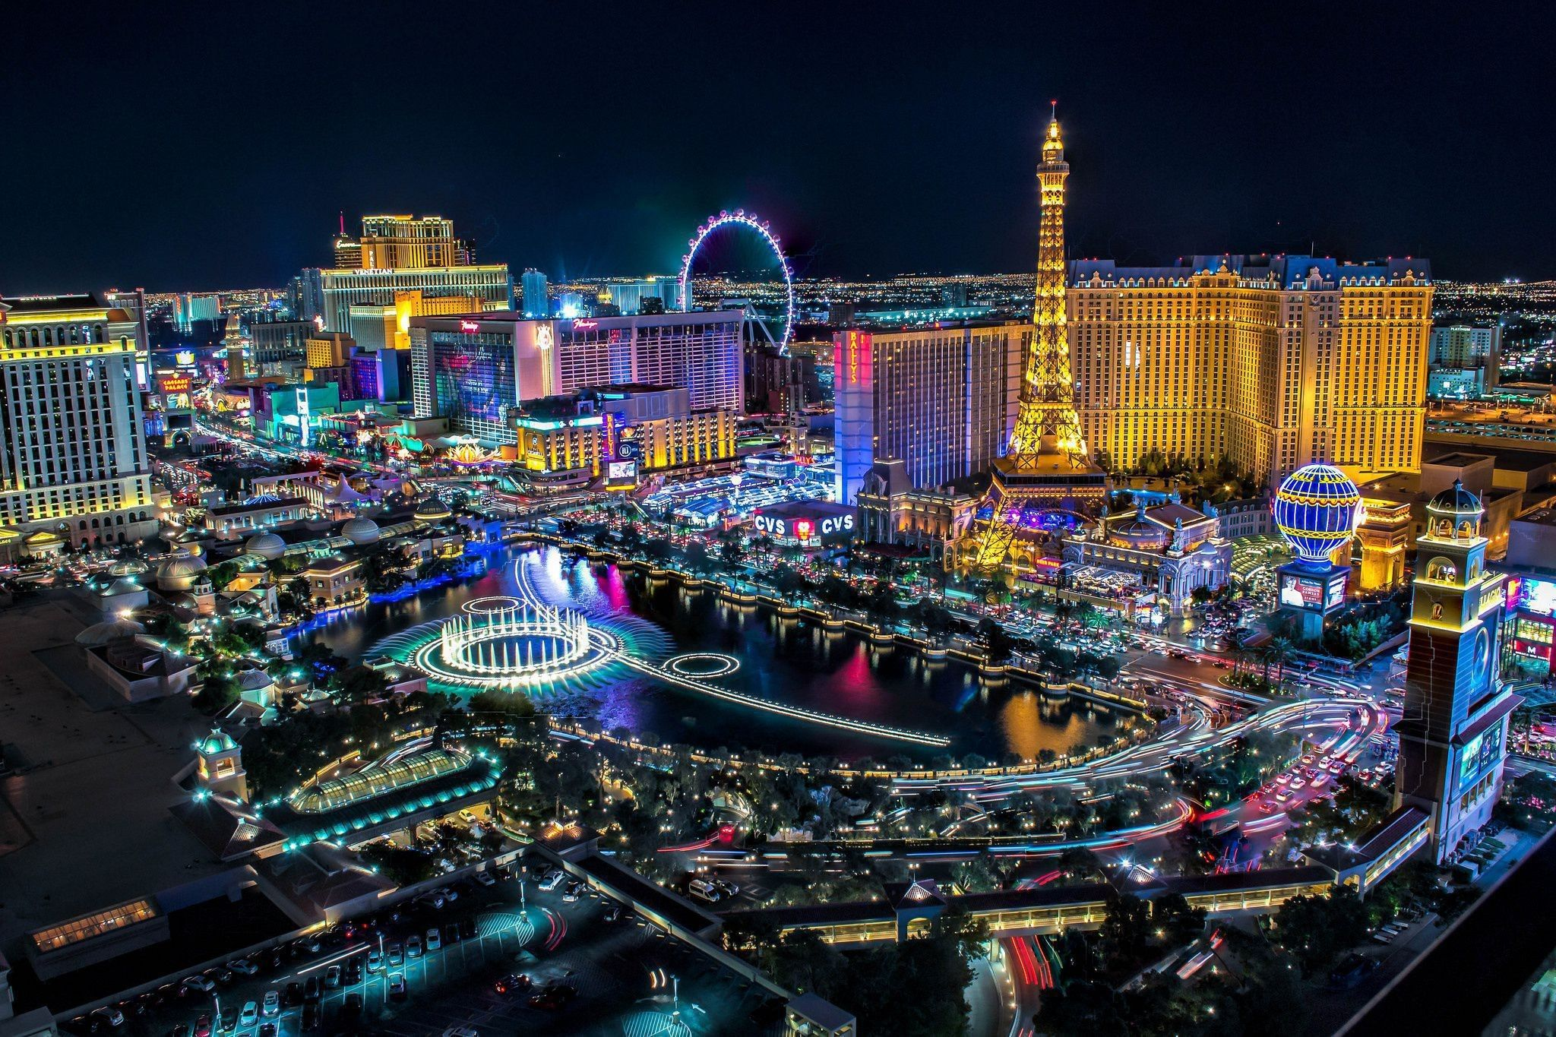
VERY PERI
BACKGROUND
Introducing the Pantone Color of the Year 2022. PANTONE 17-3938 Very Peri is a dynamic hue that blends the faithfulness and constancy of blue with the energy and excitement of red.
The four color palettes in this template feature Very Peri to help you express your ideas and convey the right mood. Read on to learn how to use these colors in any presentation.
The purpose of this assignment is to determine what makes a successful hotel.
For this assignment we would base this measure of success on how well a hotel is rated on TripAdvisor.
We will be looking at variables such as the hotel guest’s details, and the amenities that the hotels provide, and observe how that will influence a hotel’s review score.

Slide 3
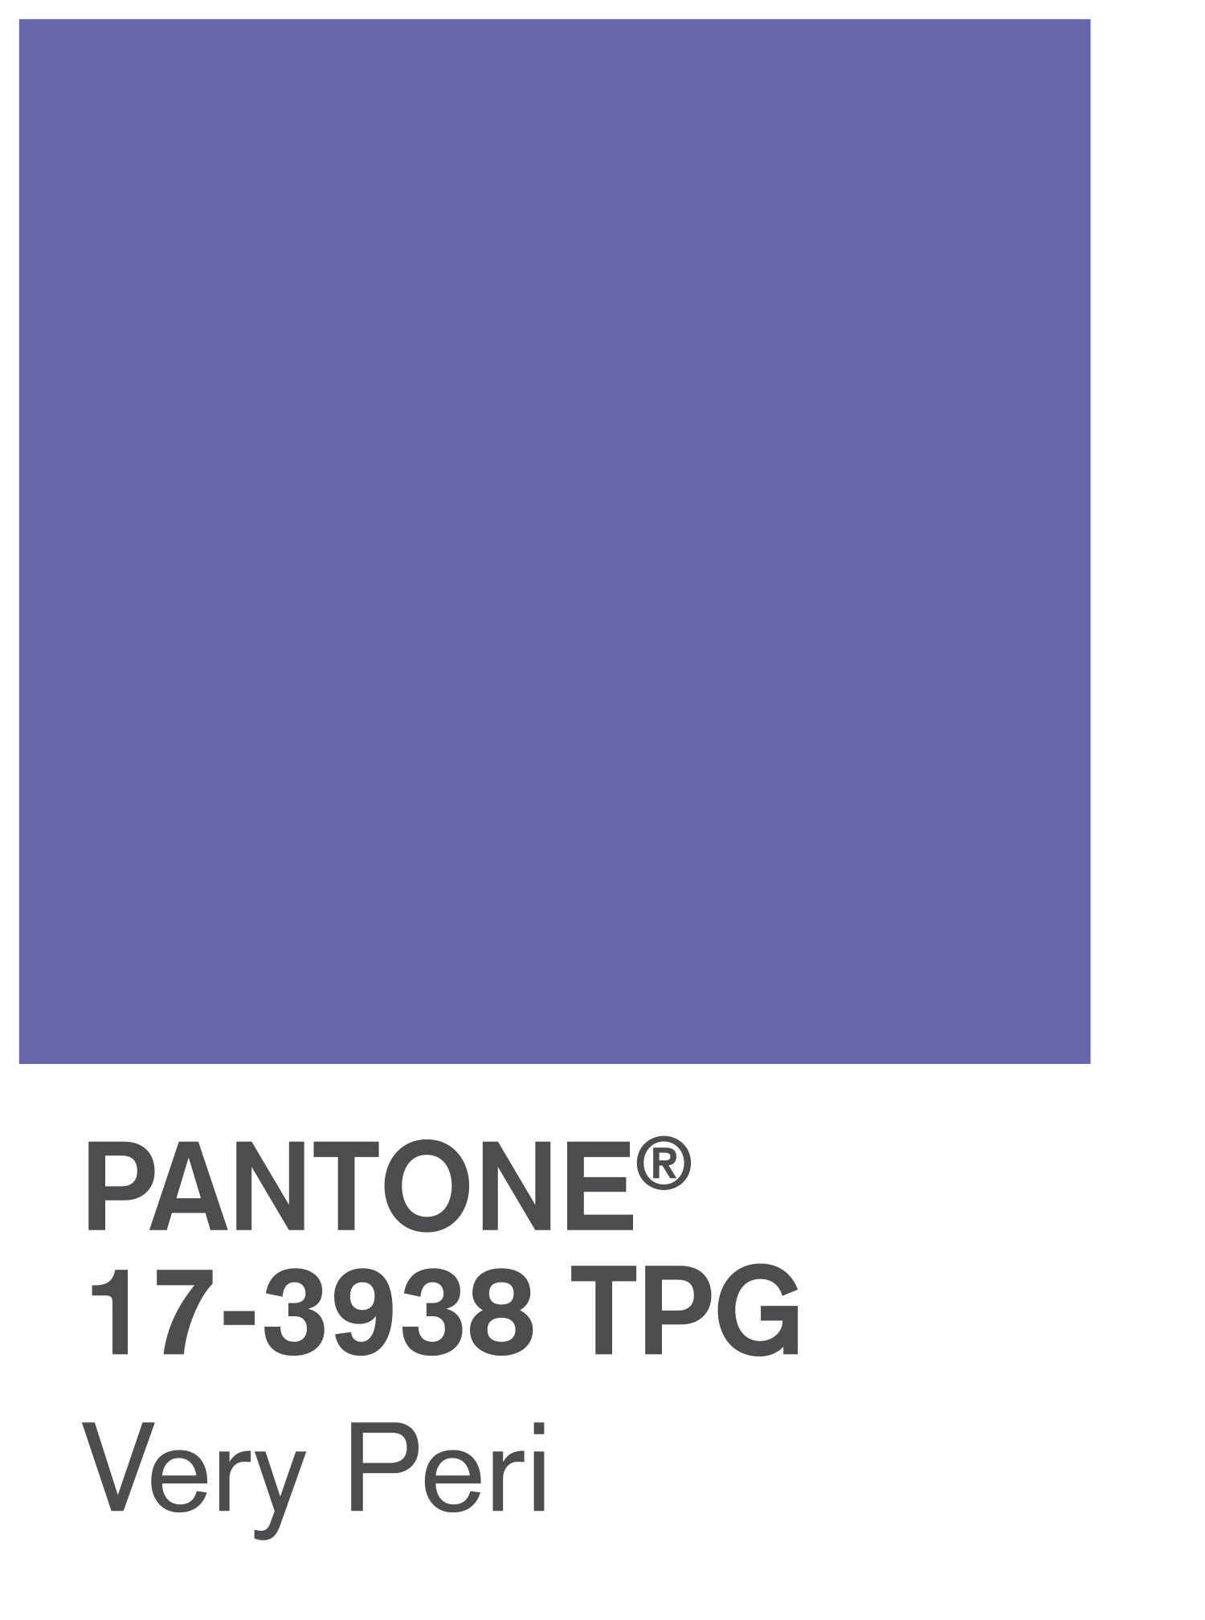
VERY PERI
DATASET
The dataset used for this assignment is obtained from UCI [1].
It contains 24 TripAdvisor ratings for 21 hotels each in Las Vegas
We will be looking at variables such as the hotel guest’s details, and the amenities that the hotels provide, and observe how that will influence a hotel’s review score.
Introducing the Pantone Color of the Year 2022. PANTONE 17-3938 Very Peri is a dynamic hue that blends the faithfulness and constancy of blue with the energy and excitement of red.
The four color palettes in this template feature Very Peri to help you express your ideas and convey the right mood. Read on to learn how to use these colors in any presentation.
Attributes:
User country – Where the reviewer originates from
Nr. Reviews – How many reviews the reviewer has written on TripAdvisor
Nr. Hotel Reviews – How many hotel reviews the reviewer has written on TripAdvisor
Helpful Votes – How many “likes” the review received
Traveler Type – Type of trip (family, business)
Pool – Has Pool
Tennis Court – Has tennis court
Spa - Has spa
Casino - Has casino
Free Internet – Has Free Internet
Hotel Name – Name of Hotel
Hotel Stars – How many stars the hotel has
Nr. Rooms – Number of rooms in a hotel
Member Years – How long the reviewer has been a member

Slide 4
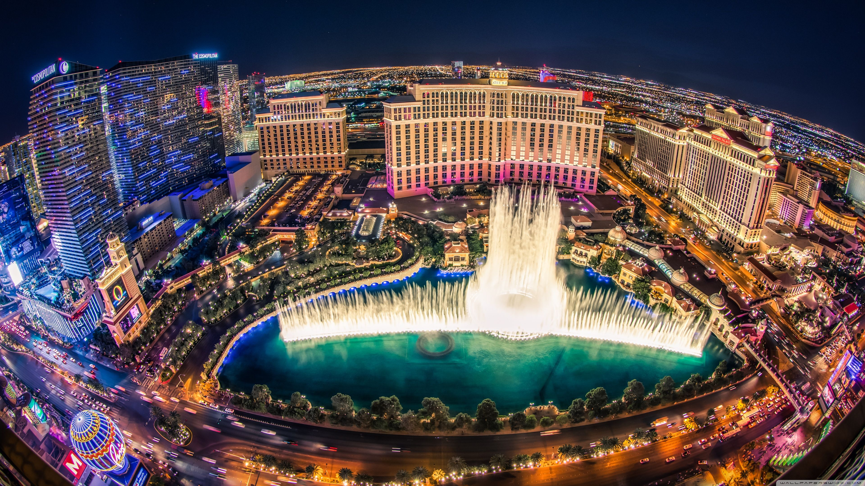
How we would measure it
We would take every score and multiply it by the amount of “helpful votes” it received, we would then use this as the final score.
For every vote, is another user that also believes that the hotel is worthy of said score.

Slide 5
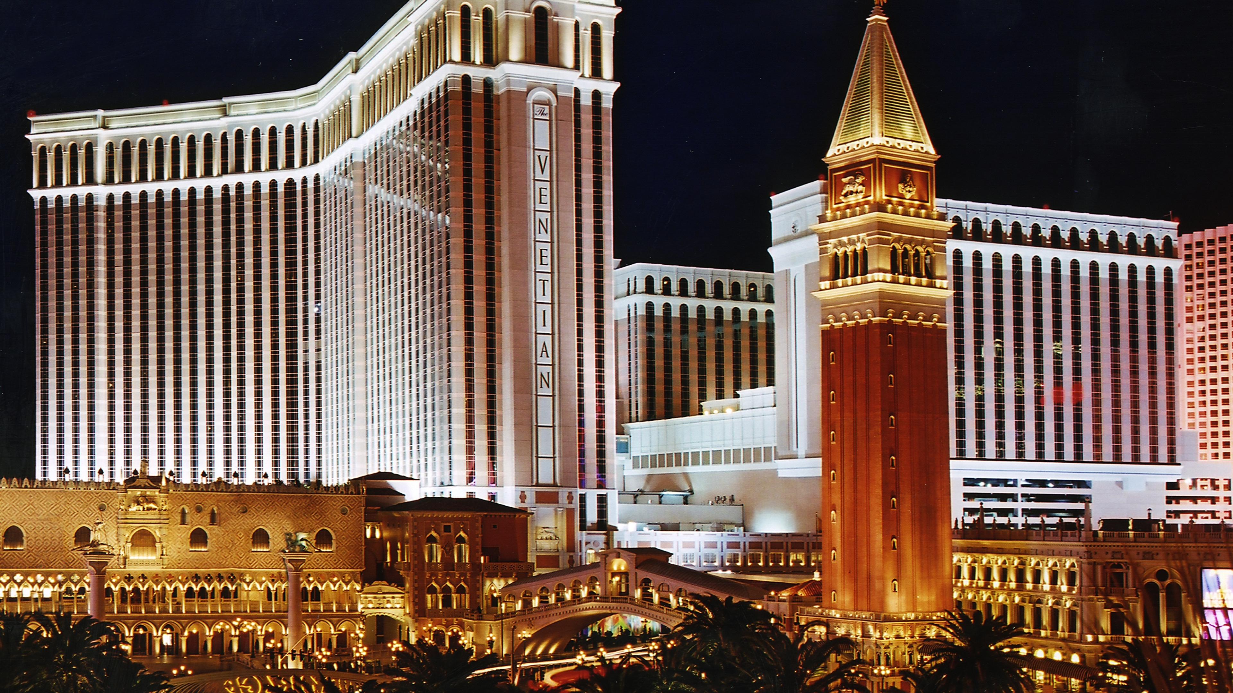
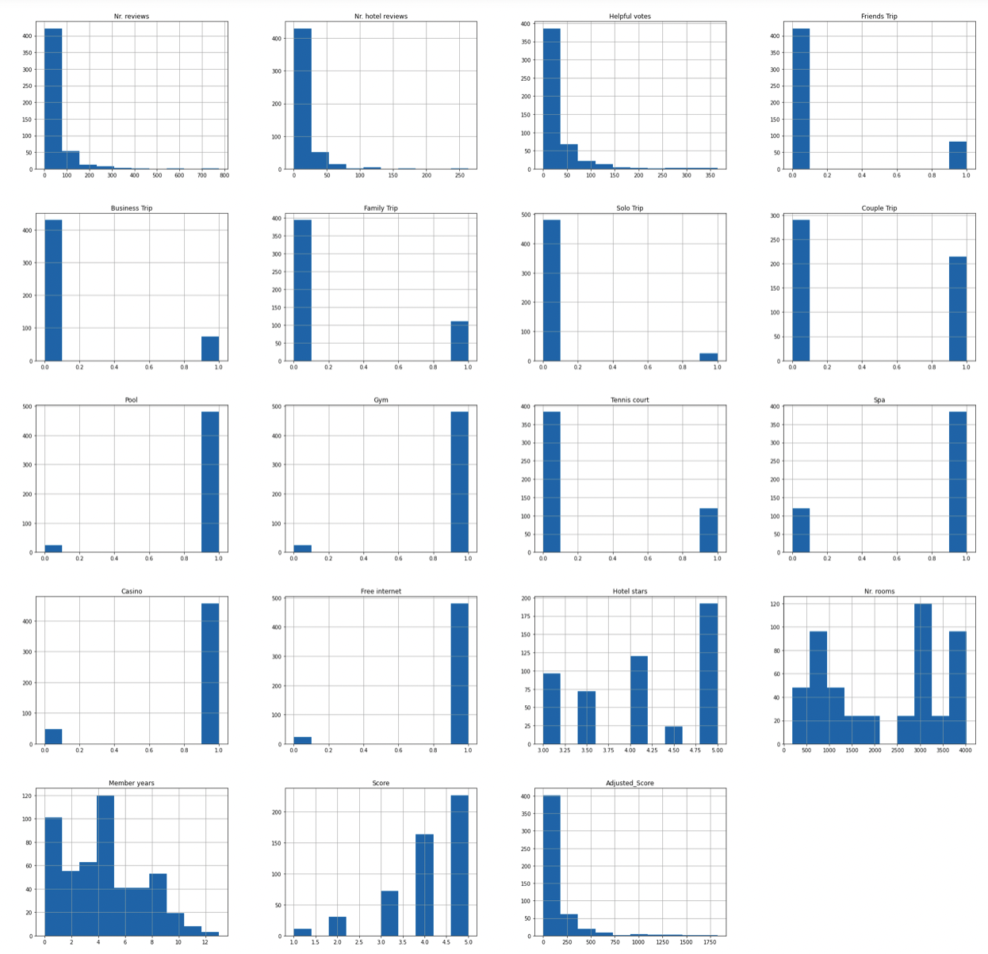
Data EXploration
There are a total of 504 reviews in the dataset (24 reviews for every 21 hotels.
Most reviewers originate from the USA🇺🇸 (217 reviews), followed by UK🇬🇧 (72 reviews) and Canada🇨🇦 (65 reviews)
There seems to be disproportionately more couple trips.
Most reviewers are new (barely any other reviews)
Most hotels have a pool, gym, spa, casino, and free internet
Only some hotels have a tennis court
The shape of the distribution of score is left skewed, but right
Skewed once adjusted for the number of helpful votes.

Slide 6
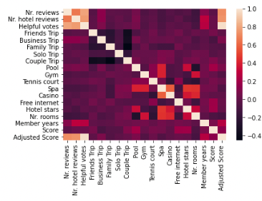
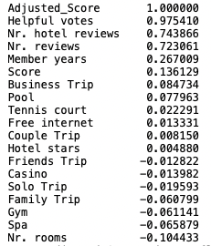
Results of correlation
The guest has a greater impact on the score of a rating than any amenities the hotel provides.
This includes how many reviews they have written (with a greater emphasis on hotel specific reviews), and how long the user has been a reviewer on TripAdvisor.
People on business trips also seem to leave higher reviews, while people on family trips tend to leave lower reviews.
The amenities that generate the best ratings are pool, tennis court, and free internet
Hotels with spas, gyms, and casinos tend to receive lower ratings
The amount of star a hotel has while having an affect, barely correlates to the adjusted score
Smaller hotels seems to have better reviews

Slide 7
Linear Regression
Adjusted Score = -205.786 + 1.188 (Nr. Reviews) + 3.908 (Nr. Hotel Review) + 12.178 (Friends Trip) -12.351 (Business Trip) – 7.478 (Business Trip) - 4.411 (Family Trip) + 12.061 (Solo Trip) + 31.119 (Couple Trip) + 22.717 (Pool) + 31.695 (Gym) - 44.355 (Tennis court) + 46.342 (Spa) + 32.170 (Casino) + 32.170 (Free Internet) + 20.516 (Hotel Stars) + 0.00281 (Nr. Rooms)+ 5.850 (Member Years)
Accuracy score = 0.671

Slide 8
Linear Regression (Train, test)
Adjusted Score = -179.952 + 1.159 (Nr. Reviews) + 3.988 (Nr. Hotel Review) + 20.324 (Friends Trip) +3.402 (Business Trip) -6.904 (Business Trip) – 16.417 (Family Trip) – 0.404 (Solo Trip) + 57.470 (Couple Trip) – 29.892 (Pool) + 16.879 (Gym) – 44.199 (Tennis court) + 62.997 (Spa) + 70.272 (Casino) + 5.714 (Free Internet) + 5.714 (Hotel Stars) + 0.00688 (Nr. Rooms)+ 7.192(Member Years)
Accuracy score = 0.590

Slide 9
Comparing actual data
Highest adjusted score = 6051
Marriott’s Grand Chateau
Users have accumulated 2161 reviews, 730 hotel reviews
1376 helpful votes
3 friend trips, 6 business trips, 7 family tips, 8 couple trips
Pool
Gym
Casino
Free internet
3.5 star
1228 rooms
Lowest adjusted score = 1417
Circus Circus Hotel & Casino Las Vegas
Users have accumulated 701 reviews, 187 hotel reviews
444 helpful votes
7 friend trips, 1 business trips, 8 family tips, 1 solo trip, 7 couple trips
Gym
Casino
Free internet
3 star
3773 rooms

Slide 10
Conclusion
For a hotel to have a good rating on TripAdvisor, it must focus more on attracting experienced hotel critics rather than improve on its amenities.
They should also be aware that guests who are staying for business tend to leave better reviews.
The amenities that generate the better ratings are pool, tennis court, and free internet.
And that a bigger hotel does not necessarily generate better reviews.

Slide 11
References
https://archive.ics.uci.edu/ml/datasets/Las+Vegas+Strip#

